Slide 1
Multimedia Systems Lecture – 11
By
Dr. Priyambada Subudhi
Assistant Professor
IIIT Sri City

Slide 2
Color Model
A color model is an orderly system for creating a whole range of colors from a small set of primary colors (are the set of colors that can be combined to make an useful range of colors).
Color Gamut: Set of all colors that we can produce from the primary colors.
There are two types of color models.
Additive color model (e.g. RGB color model)
Subtractive color model (e.g. CMY color model)
Additive color models use light to display color while subtractive models use printing inks.
Colors perceived in additive models are the result of transmitted light while the colors perceived in subtractive models are the result of reflected light.

Slide 3
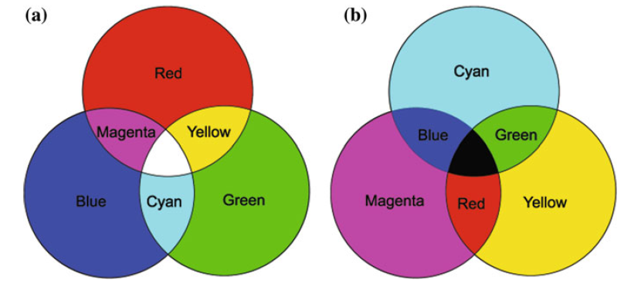
There are several established color models used in computer graphics, but the two most common are the RGB model (Red-Green-Blue) for computer display and the CMYK model (Cyan-Magenta-Yellow-Black) for printing.
Additive and subtractive color. a RGB is used to specify additive color. b CMY is usedto specify subtractive color

Slide 4
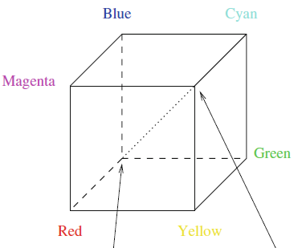
RGB Model
The red, green, and blue (RGB) color space is widely used throughout computer graphics.
Unit Cube defined on R, G & B axes.
The Origin (0,0,0) represents black and the diagonally opposite vertex (1,1,1) is White.
Vertices of the cube on the axes represent primary colors, and the remaining vertices are the complementary color points for each of the primary colors.
Shades of gray are represented along the main diagonal.
RGB color Cube
Black(0,0,0) White(1,1,1)

Slide 5
Each color point within the unit cube can be represented as w weighted vector sum of the primary colors, using unit vectors R,G and B.
C(λ) =RR+GG+BB
Where R, G and B are the assigned values in the range from 0 to 1.0
For example, the magenta vertex is obtained by adding the maximum red and blue values to produce : (1,0,1)

Slide 6
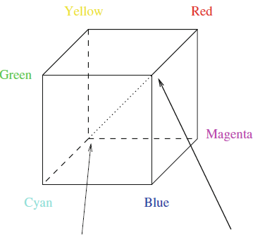
CMY and CMYK model
Subtractive Color Model.
Stands for cyan-magenta-yellow.
Used for hardcopy devices (ex. Printers).
A printed color that looks red absorbs the other two components G and B and reflects R.
Thus the C-M-Y coordinates are just the complements of the R-G-B coordinates.
CMY color Cube
White (0,0,0) Black(1,1,1)

Slide 7
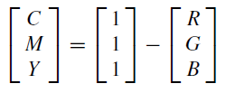
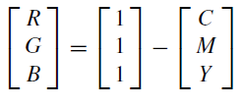
In additive color models such as RGB, white is the “additive” combination of all primary colored lights, while black is the absence of light.
In the CMYK model, it is the opposite: white is the natural color of the paper or other background, while black results from a full combination of colored inks.
Transformation from RGB to CMY and CMY to RGB
[Complementary colors: Pairs of colors which, when combined in the right proportions, produce white. Example, in the RGB model: red & cyan , green & magenta , blue & yellow.]

Slide 8
CMYK Model
Although cyan, magenta and yellow inks might be expected be sufficient for color printing, most actual color printing uses black ink in addition.
This is partly because a mixture of the first three inks may not yield a black that is neutral enough, or dark enough, but also because the use of black spares the use of the more expensive colored inks, and also reduces the total amount of ink used, thus speeding drying times.
K used instead of equal amounts of CMY

Slide 9
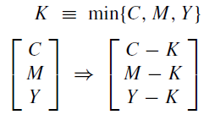
Truly “black” black ink is in fact cheaper than mixing colored inks to make black, so a simple approach to producing sharper printer colors is to calculate that part of the three-color mix that would be black, remove it from the color proportions, and add it back as real black. This is called “undercolor removal.”
With K representing the amount of black, the new specification of inks is thus

